Slide 1

Sculpting Smart Distance Monitoring

Slide 2

LIST OF COMPONENTS:
ESP32 MICROCONTROLLER
ULTRASONIC SENSOR(HC-SR04)
BREAD BOARD
JUMPER WIRES

Slide 3
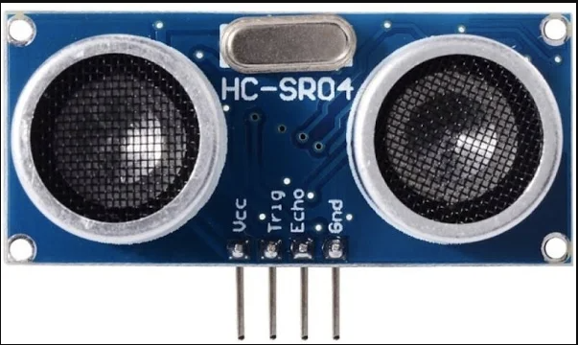
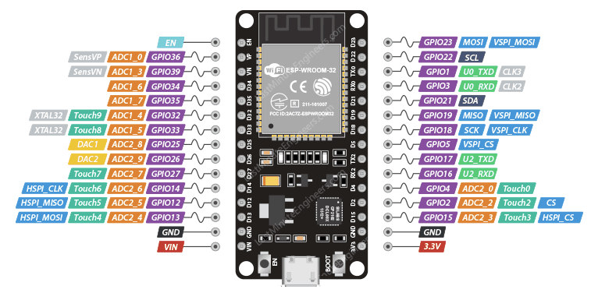
CIRCUIT DAIGRAM:
CONNECT TRIG PIN-D5

Slide 4
CONNECT ECHO PIN -D18

Slide 5
CONNECT VCC-3.3V

Slide 6
CONNECT GND-GND

Slide 7
CODE:
#define TRIG_PIN 5
#define ECHO_PIN 18
#define OBSTACLE_DISTANCE 20
void setup() {
Serial.begin(115200);
pinMode(TRIG_PIN, OUTPUT);
pinMode(ECHO_PIN, INPUT);
}
void loop() {
long duration, distance;
digitalWrite(TRIG_PIN, LOW);
delayMicroseconds(2);
digitalWrite(TRIG_PIN, HIGH);
delayMicroseconds(10);
digitalWrite(TRIG_PIN, LOW);
duration = pulseIn(ECHO_PIN, HIGH);
distance = duration * 0.034 / 2;
Serial.print("Distance: ");
Serial.print(distance);
Serial.println(" cm");
if (distance <= OBSTACLE_DISTANCE) {
Serial.println("Obstacle detected!");
}
delay(500);
}

Slide 8
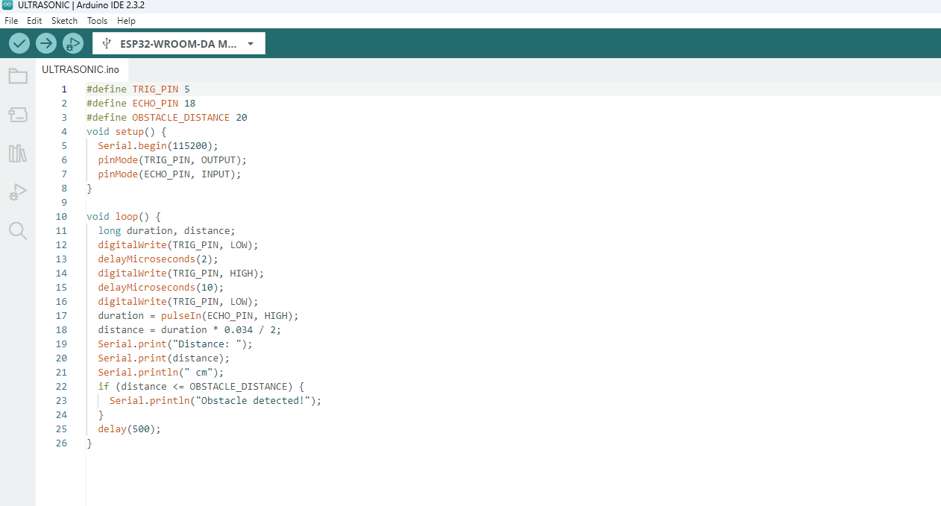
STEP 1
Copy code paste in Arduino new Sketch

Slide 9
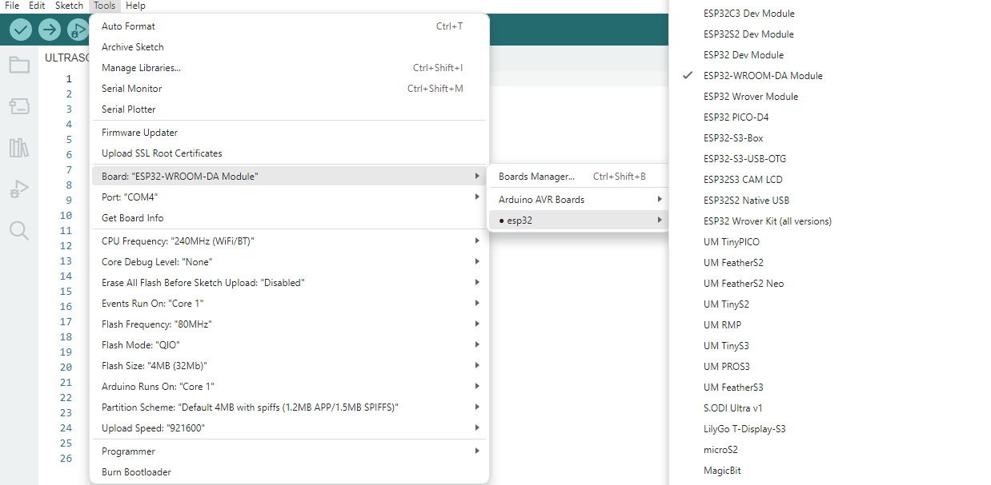
STEP 2:
Board---->esp32---->esp32-wroom-DA module

Slide 10
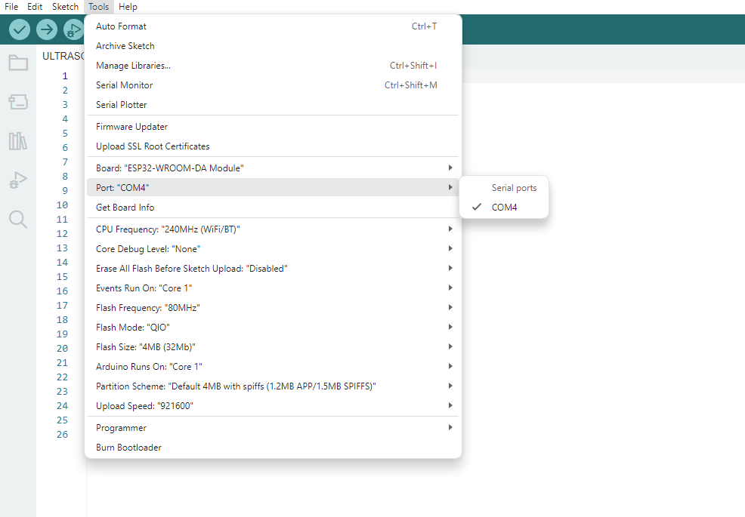
STEP 3:
Tools---->port---->select your com

Slide 11
board name automatically change to dark

Slide 12
2.After Compilation build the code to board
1.Compile the code

Slide 13
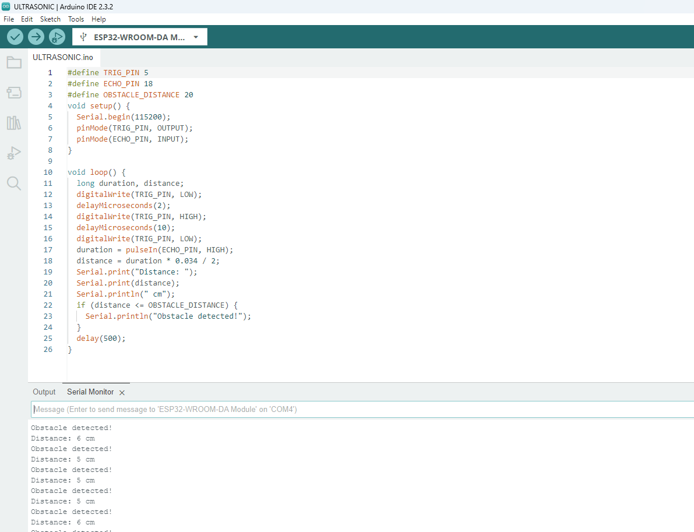
After Build the code the output like this

